Slide 1
Multithreading and Synchronization

Slide 2
Outline
Introduction
Creating Threads
Thread lifecycle
Common thread methods
Daemon Threads

Slide 3
Introduction
In computing, multitasking allows a user to perform more than one computer task at a time.
The operating system can keep track of where you are in these tasks and go from one to the other without losing information.

Slide 4
Introduction
During multitasking, tasks that are not visible to the user are called background while tasks that the user is currently using and is directly visible are called foreground.

Slide 5

Java Threads
Threads allows a program to operate more efficiently by doing multiple things at the same time.
Threads can be used to perform complicated tasks in the background without interrupting the main program.

Slide 6
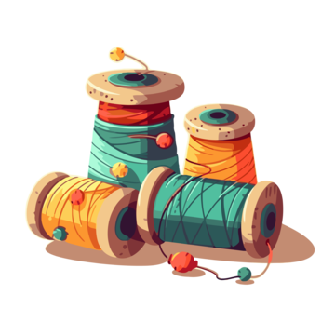
Multithreading
MultiThreading is the process of executing multiple threads simultaneously that helps maximum utilization of the CPU.
Each thread are independent, they do not affect execution of other threads. An exception in one thread will not interrupt other threads
Mostly used for serving multiple clients, multiplayer games or other mutually independent tasks.

Slide 7
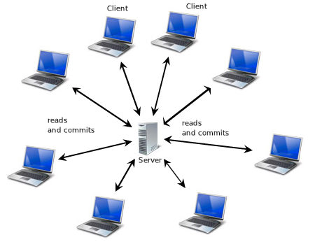
Real world use cases
Server handling multiple requests from different clients simultaneously

Slide 8
Real world use cases
Multiplayer games

Slide 9

Creating a Thread
Animal.java
MyThread.java
public class MyThread extends Thread{
@Override
public void run() {
System.out.println("This is a user thread that is running");
}
}
There are two ways to create a thread. The first option is to extend the Thread class.

Slide 10
Creating a Thread
Animal.java
MyRunnable.java
public class MyRunnable implements Runnable{
@Override
public void run() {
System.out.println("This is a user thread that is running");
}
}
The second option is to implement the
Runnable interface.

Slide 11
New
stop()
start()
Runnable
stop()
Dead
run()
Running
End of execution
sleep()
Blocked
stop()

Slide 12
New
stop()
start()
Runnable
stop()
Dead
run()
Running
End of execution
sleep()
Blocked
stop()
New State. As we use the Thread class to construct a thread entity, the thread is born and is defined as being in the New state.

Slide 13
New
stop()
start()
Runnable
stop()
Dead
run()
Running
End of execution
sleep()
Blocked
stop()
Runnable State. A thread in the runnable state is prepared to execute the code. When a new thread's start() function is called, it enters a runnable state.

Slide 14
New
stop()
start()
Runnable
stop()
Dead
run()
Running
End of execution
sleep()
Blocked
stop()
Runnable State. A thread in the runnable state is prepared to execute the code. When a new thread's start() function is called, it enters a runnable state.

Slide 15
New
stop()
start()
Runnable
stop()
Dead
run()
Running
End of execution
sleep()
Blocked
stop()
Runnable State. A thread in the runnable state is prepared to execute the code. When a new thread's start() function is called, it enters a runnable state.

Slide 16
New
stop()
start()
Runnable
stop()
Dead
run()
Running
End of execution
sleep()
Blocked
stop()
Dead State. When a thread's run() function ends the execution of sentences, it automatically dies or enters the dead state. That is, when a thread exits the run() process, it is terminated or killed. When the stop() function is invoked, a thread will also go dead.

Slide 17
Method | Description
run() | Returns the number of active threads
start() | Changes the name of the thread
sleep(milliseconds) | Returns the name of the thread
activeCount() | Returns the number of active threads
setName() | Changes the name of the thread
getName() | Returns the name of the thread
join | Waits for a thread to die
join(milliseconds) | Waits for a thread to die for the specified milliseconds

Slide 18
Method | Description
setPriority() | Changes the priority of the thread 1 – lowest priority 5 – default priority 10 – Highest priority
getPriority() | Returns the priority of the thread
isAlive() | Returns true if the thread is active
isDaemon() | Returns true if the thread is a Daemon thread.
setDaemon() | Marks the thread as a daemon or user thread

Slide 19
Daemon Threads
A daemon thread is a background thread that does not prevent the Java Virtual Machine (JVM) from exiting when all user (non-daemon) threads finish execution.

Slide 20
Daemon Threads
A low priority thread that runs in background to perform tasks such as garbage collection.
All non-daemon threads are referred to as User threads.

Slide 21
Creating a Thread
Animal.java
Main.java
public class Main{
public static void main(String[] args) {
MyThread thread = new MyThread(); // Create a new thread instance
thread.setDaemon(true); // set the thread as a daemon thread
System.out.println(thread3.isDaemon()); // prints true
}
}
The second option is to implement the
Runnable interface.

